Slide 1
Java – Collections Framework

Slide 2
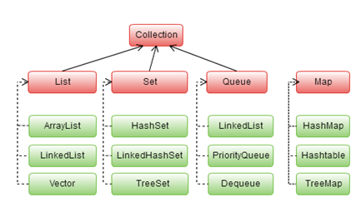
Java Collection Framework - JCF
Collection is an object representing a group of objects.
Collection framework contains a set of classes and interfaces which are used for representing and manipulating collections.
Collection interface is the root interface from which the interfaces List, Set,Queue are extended.

Slide 3
JCF – List
List interface:
List interface is an ordered collection in which duplicate elements are also allowed.
Elements are stored in a sequential way and hence its elements can be accessed using the index value.
ArrayList
LinkedList
Vector

Slide 4
JCF – Set Interface
Set interface:
Set is an unordered collection. It does not maintain any order while storing the elements. It does not allow duplicate elements.
if one requires to store a group of unique elements, set can be used
HashSet
LinkedHashSet
TreeSet

Slide 5
JCF – Map Interface
Map interface:
Map is an interface which maps keys to values in which each key has to be unique.
HashMap
Hashtable
TreeMap

Slide 6
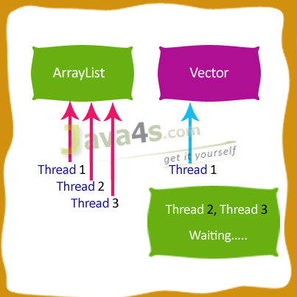
JCF – ArrayList Vs Vector
ArrayList and Vector both having same data structure internally
ArrayVector is by default synchronized, means at a time only one thread can access its methods from out side, where as ArrayList is non-synchronized means N number of threads can access at a time
But we can make ArrayList as synchronized by using Collections class, see it bellow
Both Vector and ArrayList have capability to re-size dynamically, means Vector will Doubles the size of its array when its size increased, but ArrayList increased by Half only

Slide 7
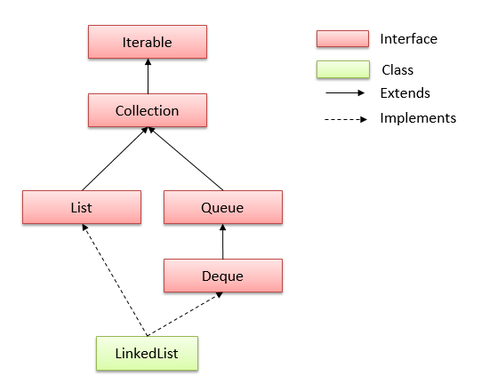
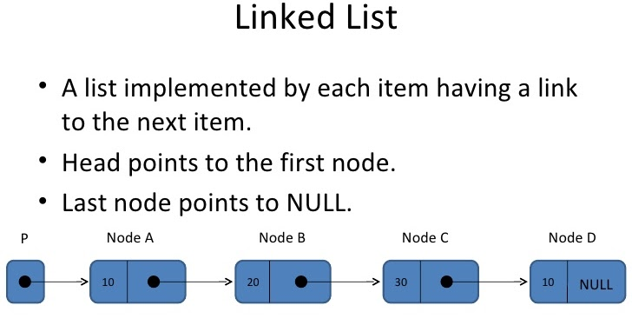
JCF – LinkedList

Slide 8
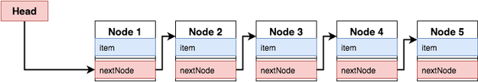
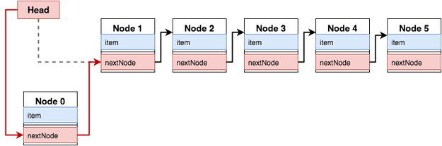
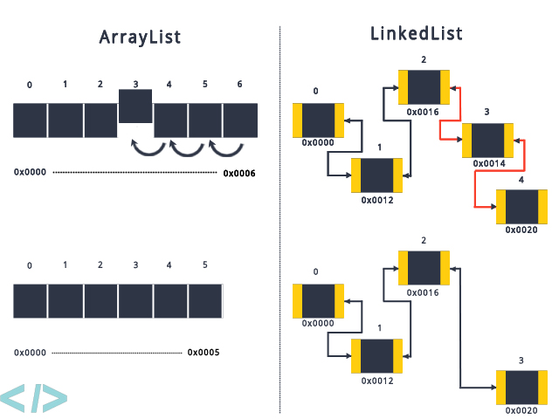
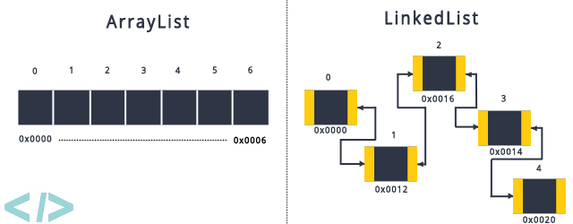
JCF – LinkedList Vs ArrayList
Element Manipulation
Element manipulation with ArrayList is slow because it uses internally Array, For storing or removing of any new element needs to shift other elements in Array.
Element manipulation with LinkedList is fast compare to ArrayList, For storing or removing of new element needs to update the node address only.
Memory Allocation
ArrayList uses Array as underline datastructure to store the elements, and we know Array stores elements in consecutive manner.
In LinkedList, elements can be stored at any available memory location as address of node is stored in previous node.
Element Retrieval
Element retrieval in ArrayList is much faster then LinkedList, ArrayList take O(1) of time to retrieve any location where LinkedList take O(n) time to retrieve the element.

Slide 9
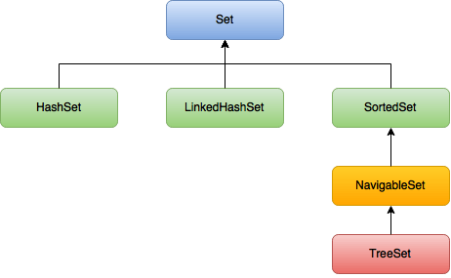
JCF – Set
Set in Java
Set is an interface which extends Collection.
It is an unordered collection of objects in which duplicate values cannot be stored.
Basically, Set is implemented by HashSet, LinkedHashSet or TreeSet (sorted representation).
Set has various methods to add, remove clear, size, etc to enhance the usage of this interface

Slide 10
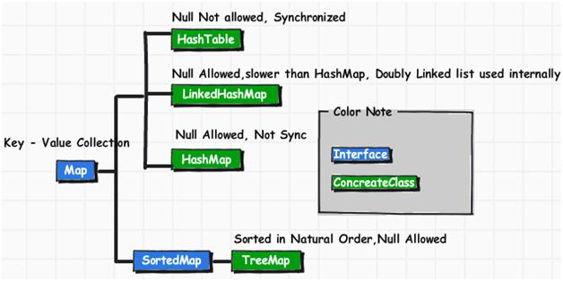
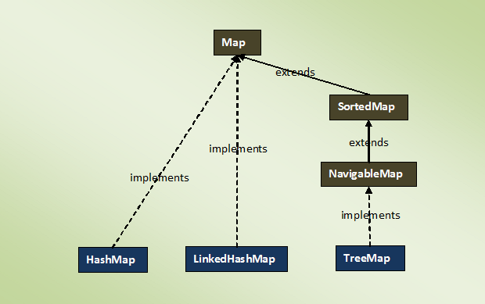
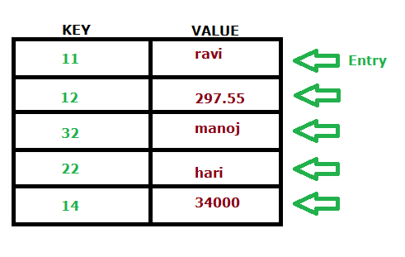
JCF – Map
Map “” an object that maps keys to values. A Map cannot contain duplicate keys; each key can map to at most one value.

Slide 11
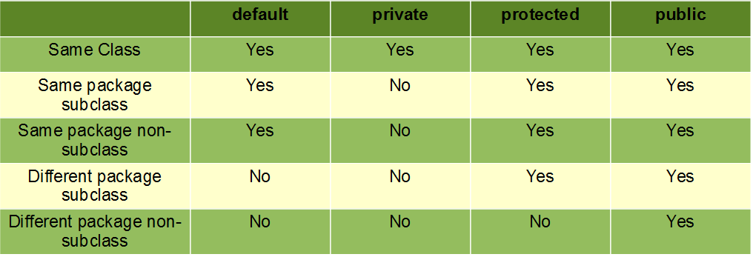
Access Modifiers:

Slide 12


